Slide 1
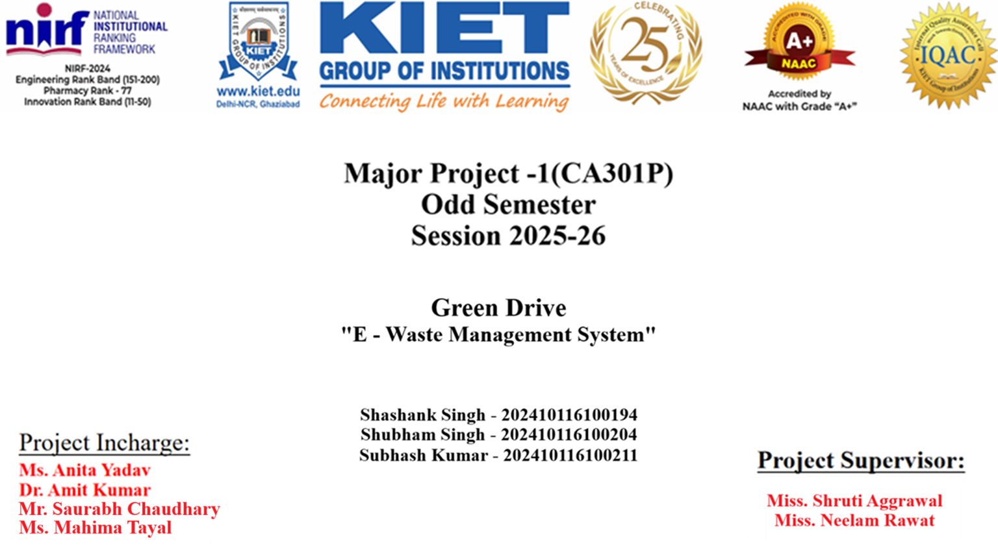

Slide 2
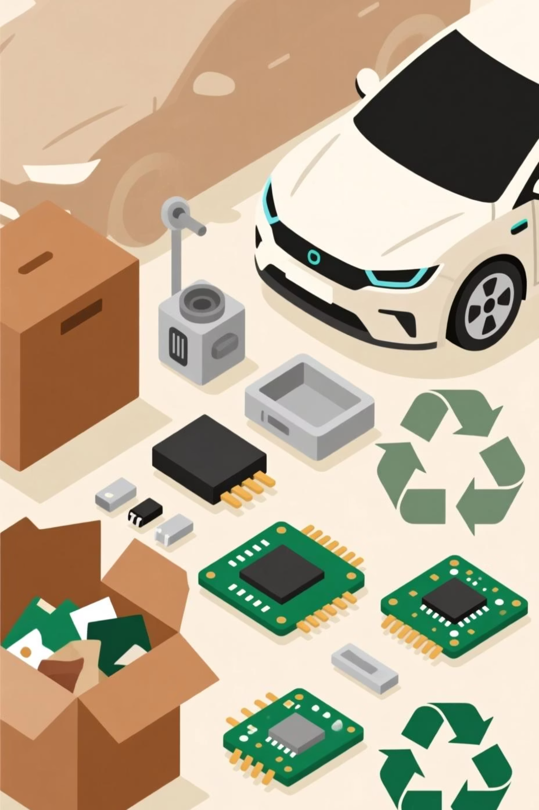
Green Drive
An E-Waste Management System for Vehicles
1

Slide 3

Evaluation Parameters
Each section of this presentation maps directly to the project rubric.
Problem Statement & Domain Understanding
15 Marks
Defined Objectives, Scope & Expected Outcomes
15 Marks
Methodology & Initial Implementation Progress
10 Marks
Research Outcome (Innovation / Publications / Patent)
10 Marks
Presentation Clarity & Quality
10 Marks
2
Total: 60 Marks
3

Slide 4

Introduction
Rapid growth of vehicles leads to increasing electronic waste (batteries, sensors, ECUs, infotainment systems, etc.)
Improper disposal causes environmental hazards and resource loss
Need for a digital solution to manage, recycle, and dispose vehicle e-waste efficiently
3

Slide 5
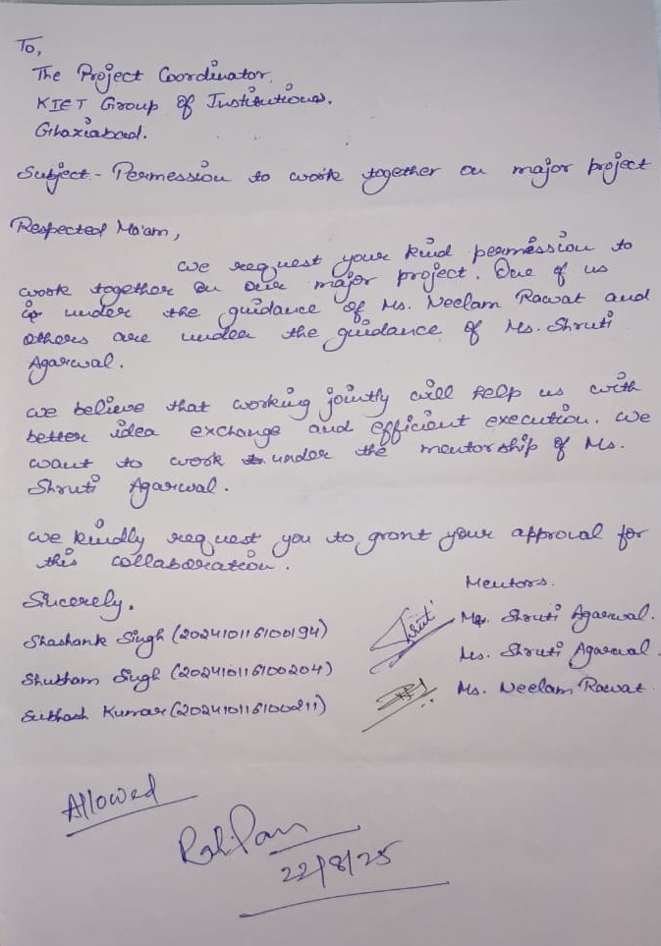
Consent Letter
4

Slide 6

Problem Statement & Domain Understanding
Lack of structured e-waste management systems specifically for automobiles
Limited awareness and tracking mechanisms for end-of-life vehicle electronics
Existing recycling approaches are mostly manual and unorganized
Our domain: Smart Waste Management & Sustainability in Automotive Sector
5

Slide 7
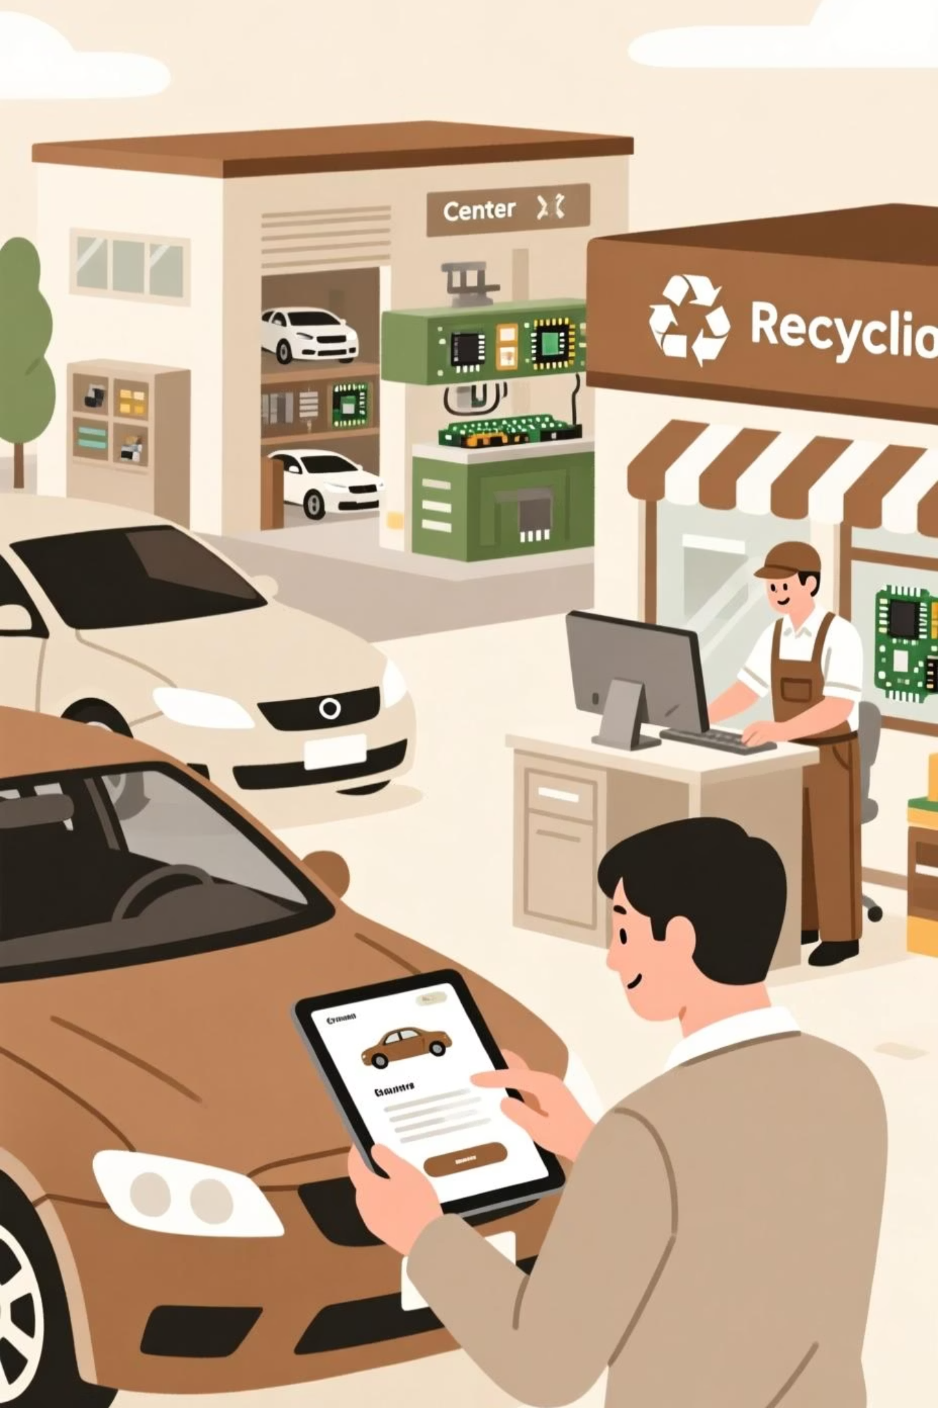
Scope & Expected Outcomes
Scope:
Expected Outcomes:
Covers automobile e-waste tracking, collection, and recycling
Reduction in improper disposal of e-waste
Platform for stakeholders (users, dealers, recyclers, govt. agencies)
Increase in recycling efficiency
Supports integration with sustainability initiatives
Digital records for better monitoring & reporting
Promotes Green & Sustainable Mobility
6

Slide 8
Defined Objectives
1
2
Web-Based Application
Connect Stakeholders
To build a web-based application for managing vehicle e-waste
Enable users, workshops, and recyclers to connect on a single platform
3
4
Information Provision
Eco-Friendly Practices
Provide information on safe disposal & recycling centers
Encourage eco-friendly practices in the automotive industry
7

Slide 9
Methodology & Tech Stack
Methodology:
Tech Stack:
Requirement Gathering
Frontend
HTML, CSS, JavaScript
System Design (Frontend + Backend)
Backend
Python (Django)
Application Development
Database
MySQL / SQLite
Testing & Validation
Additional
APIs for mapping recycling centers
Deployment
8

Slide 10
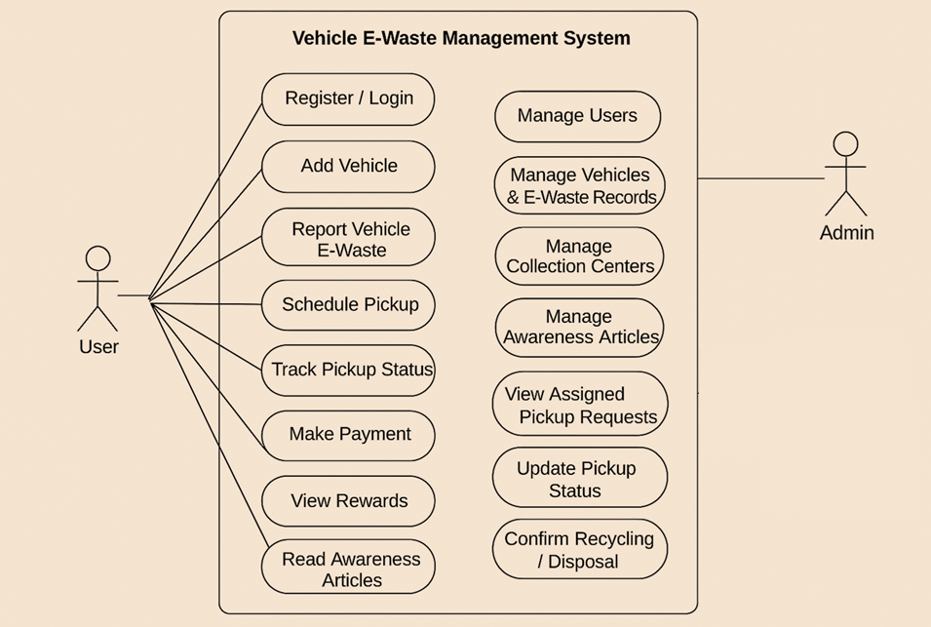
Use Case Diagram
9

Slide 11
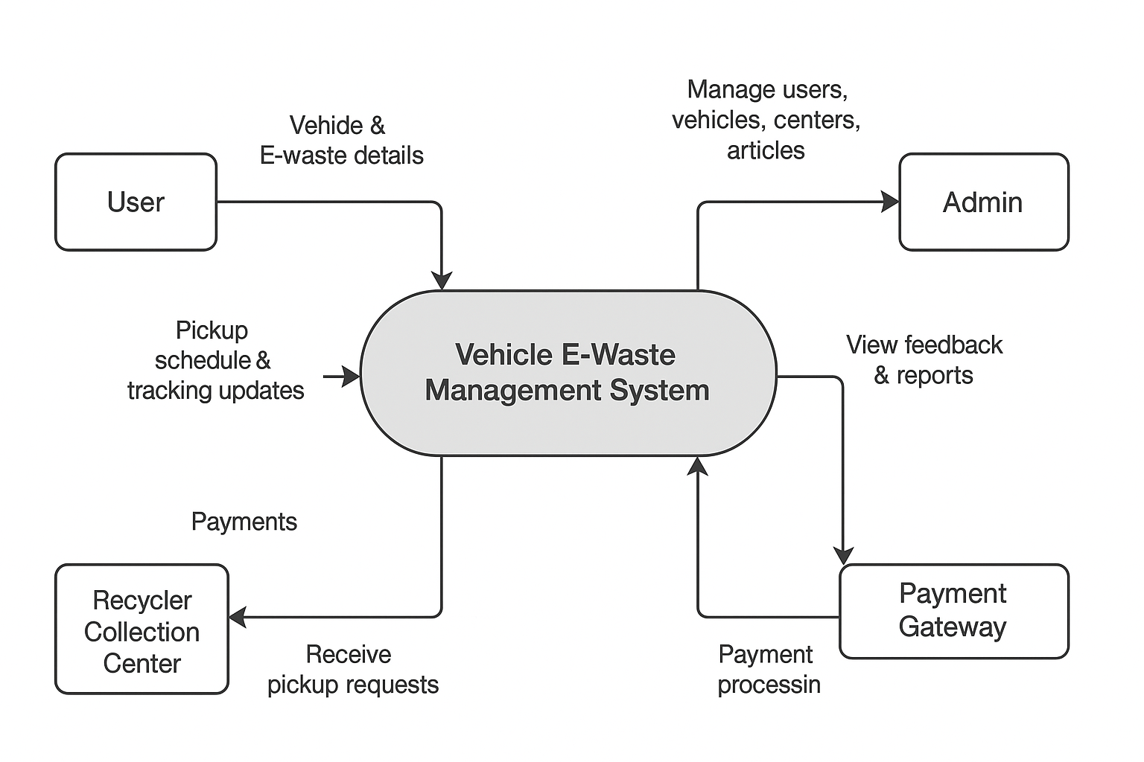
Data Flow Diagram (Level 0)
10

Slide 12
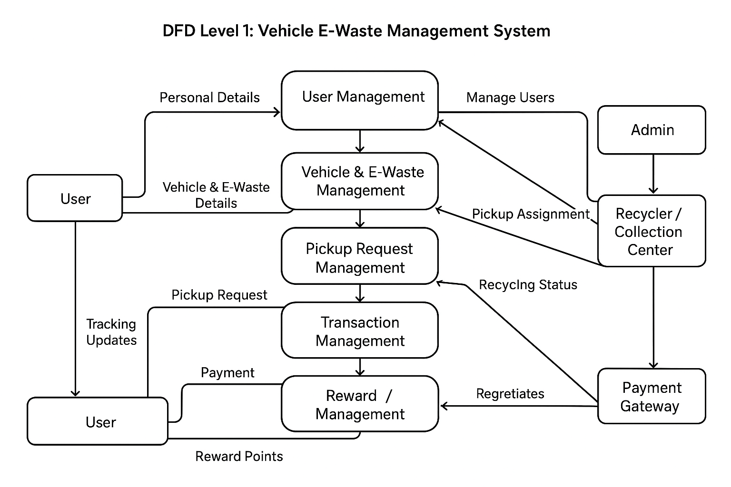
Data Flow Diagram (Level 1)
11

Slide 13
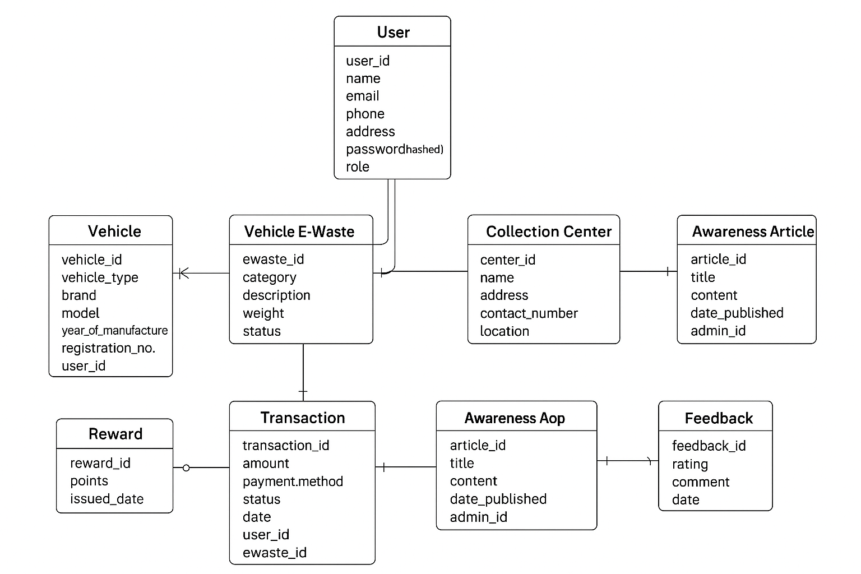
Entity Relationship Diagram
12

Slide 14





Research Outcome & Innovation
Centralized Digital Platform
Bridging Gaps
Provides a centralized digital platform for vehicle e-waste management
Bridges the gap between users and recyclers
Innovative Approach
Sustainable Development
Innovative approach: Integrates awareness + tracking + disposal
Encourages sustainable development goals (SDG 12: Responsible Consumption & Production, SDG 13: Climate Action)
13

Slide 15
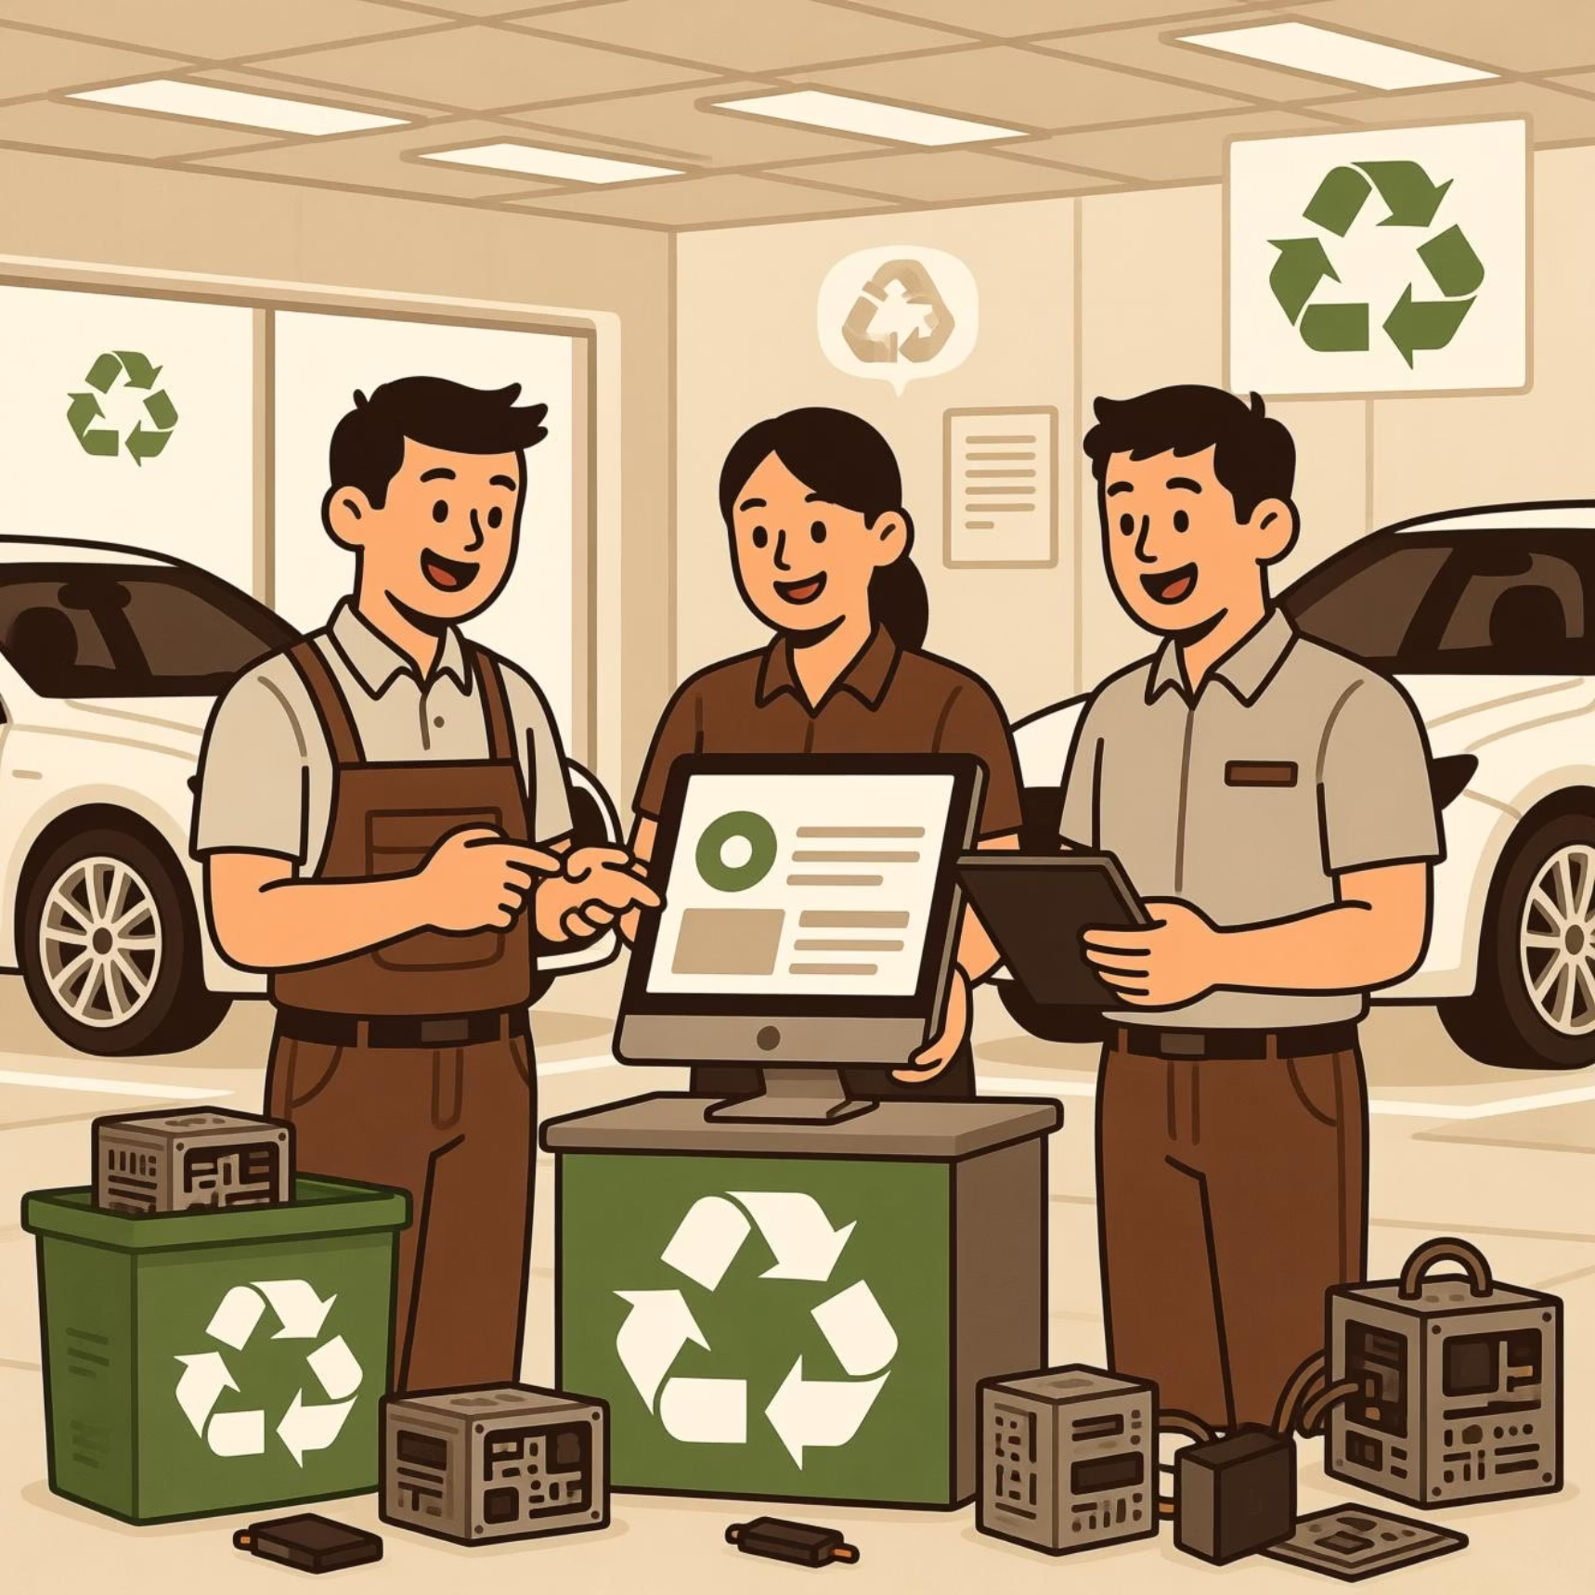
Conclusion
"Green Drive" offers a sustainable, tech-driven solution for vehicle e-waste management
Helps in reducing pollution, saving resources, and promoting recycling
With wider adoption, it can transform the way the automotive industry handles e-waste
14

Slide 16

Thank You
15

